Slide 1
CHAPTER FIVE
Graph Algorithm

Slide 2
What is a graph?
There are two standard meanings of "graph":
1. a visual representation of the relationship between the values of two or more variables
Y
X

Slide 3
What is a graph?
2. a representation of the relationships between multiple entities
the standard
computer science
use

Slide 4
What is Graph?
In applications the entities may, for instance, correspond to
  atoms, towns, electrical terminals, bus stations, computer, telephone box, or anything that can be connected in pairs
  The lines may be chemical bonds, roads, wires, network cable, telephone line or other connections
Applications of graph theory are found in communications, electrical networks, transport systems, social networks and computer science

Slide 5
Examples
representing main roads for route planning
Beruit
German
ETH
USA
Canada
Italy

Slide 6
Examples
augmented with travel cost
note: numbers attached to links
Beruit
120
170
German
ETH
110
200
USA
150
210
90
Canada
Italy
180

Slide 7
Graph Interpretations
Apartment Blueprint: The vertices could represent rooms in a house, and the edges could indicate which of those rooms are connected to each other.
Living Dinning
Room
Hall
Bed
Kitchen Bath
Living Room Dinning Bedroom
Kitchen Hallway Bath
Sitotaw
Dawit
Almaz
Friendship Graphs: Each vertex represents a person, and each edge indicates that the two people are friends.
Tamrat
Zewditu
Petros
Notes:
Our question might be, how can I get from the Kitchen to the bathroom while going through the fewest other rooms?

Slide 8
Graph Basics
A graph is a finite nonempty set of objects called vertices together with a (possibly empty) set of unordered or ordered pairs of distinct vertices called edges
It is also formally denoted by G(V, E) where V is set of vertices and E is set of edges
If the edges are ordered pair it is called digraph (directed graph) as each edge has specific source and destination vertices
If the edges are unordered pair, we usually refer it as graph and each edge do not specify source and destination vertices

Slide 9
Graph Basics
Draw a link for the following graphs based on the graph information given below
V = {1,2,3,4,5,6,7} E = {(1,2),(1,3),(4,5),(5,6),(5,7),(6,7)}
V = {1,2,3,4,5} E = {(1,2),(2,3),(3,4),(4,3),(3,5),(5,4)}

Slide 10
Graph Basics
Draw a link for the following di-graphs based on the graph information given below
V = {1,2,3,4,5,6,7} E = {(1,2),(1,3),(4,5),(5,6),(5,7),(6,7)}
V = {1,2,3,4,5} E = {(1,2),(2,3),(3,4),(4,3),(3,5),(5,4)}
1
4
7
5
6
2
3
1
4
2
3
5

Slide 11
Graph Basics
It is usually represented as a set of points, representing the vertices (or nodes), joined by line segments (unordered pair) or arrow (ordered pair), representing the edges
The following is an example of a graph G with 5 vertices and 6 edges
  Graph
  V={a,b,c,d,e}
  E ={(a,b), (b,e), (b,d), (b,c), (d,c), (d,e)}
  Digraph
  V={a,b,c,d,e}
  E ={(a,b), (e,b), (b,d), (c,b), (d,c), (e,d)}
a
a
b
b
e
e
d
d
c
c

Slide 12
Graph Basics
The number of vertices (|V|) in a graph/digraph is called order of a graph
The number of edges (|E|) in a graph/digraph is called size of a graph
An arc that begins and ends at the same vertex u is called a loop

Slide 13
Graph Basics
A graph/digraph in which each edge has a weight associated with it is called weighted graph/digraph
5
3
weighted graph
6
2
2
10
5
3
6
weighted digraph
2
2
10

Slide 14
Graph Basics
  A simple graph/digraph is one that contains no loops or parallel edges
    Parallel edges are edges where more than one edge connects two given vertices,
a
d
b
e
c
f
  A multi-graph/multi-digraph is a graph that contains multiple edges.
  Edge is not a set in multi-graph rather it is a bag
a
d
b
e
c

Slide 15
Graph Basics
  A complete graph/digraph is a simple graph/digraph in which every pair of vertices is adjacent, that is, the graph/digraph contains all possible edges.
Complete graphs:
Not complete graphs:

Slide 16
Graph Basics
Exercise:
  Prove that a complete graph which has n vertices have 0.5n(n-1) edges
  Prove that a complete di-graph which has n vertices have n(n-1) edges

Slide 17
Graph Basics
Two vertices joined by an edge are said to be adjacent vertices.
Vertices are incident with the edge which joins them and an edge is incident with the vertices it joins
Degree of a vertex in a graph is the number of edges that connects the vertex
  The degree of a vertex in a directed graph is its in-degree plus its out-degree.
In a digraph, in-degree refers to the number of edges that incident to the vertex
indeg(V)=count ( )
In a digraph, out-degree refers to the number of edges that incident from the vertex
Outd(V)= count ( )

Slide 18
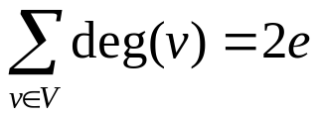
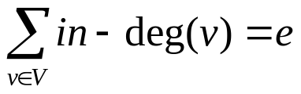
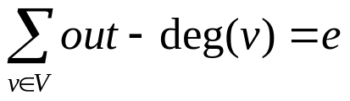
Graph Basics
Exercise:
  The sum of the degrees of a simple graph is equal to twice the number of edges in the graph. i.e. if G = (V,E), and #E = e, then
  The sum of the in-degrees of a simple di-graph is equal to the number of edges in the di-graph. i.e. if G = (V,E), and #E = e, then
  The sum of the out-degrees of a simple di-graph is equal to the number of edges in the di-graph. i.e. if G = (V,E), and #E = e, then
  For a graph the in-degree and out-degree's are the same as the degree

Slide 19
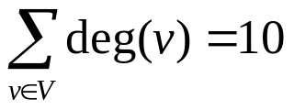
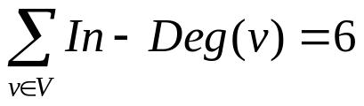
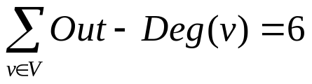
Graph Basics
a
a
b
e
b
d
e
d
c
  Graph
  Deg(a)=1
  Deg(e)=Deg(c) = 2
  Deg(d) = 3
  Deg(b) = 4
c
  Digraph
  In-Deg(a)=In-Deg(e)=0
  In-Deg(c)=1
  In-Deg(d) = 2
  In-Deg(b) = 3
  Out-Deg(b)= Out-Deg(a)=Out-Deg(d)=Out-Deg(c)=1
  Out-Deg(e)=2

Slide 20
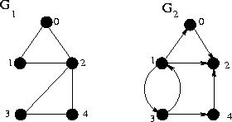
Graph Basics
For graph G₁, we have
  deg(0)=2,
  deg(1)=2,
  deg(2)=4,
  deg(3)=2 and
  deg(4)=2
For graph G₂, we have
  indegree(0)=1, outdegree(0) = 1
  indegree(1)=1, outdegree(1) = 3
  indegree(2)=3, outdegree(2) = 0
  indegree(3)=1, outdegree(3) = 2
  indegree(4)=1, outdegree(4) = 1

Slide 21
Graph Basics
The degree sequence of a graph G is the sequence obtained by listing, in ascending order with repeats, the degrees of the vertices of G.
For example, in figure below the degree sequence of G is (1, 2, 2, 3, 4) )

Slide 22
Graph Basics
For the graph G₁, we have deg(0)=2, deg(1)=2, deg(2)=4, deg(3)=2 and deg(4)=2
We may concisely write this as a degree sequence (2, 2, 4, 2, 2) if there is a natural ordering (e.g., 0,1, 2, 3, 4) of the vertices

Slide 23
Graph Basics
The in-degree sequence and out-degree sequence of the digraph G₂ are (1, 1, 3, 1, 1) and (1, 3, 0, 2, 1), respectively
The degree of a vertex of a digraph is sometimes defined as the sum of its in-degree and out-degree
Using this definition, a degree sequence of G₂ would be (2, 4, 3, 3, 2)
  indegree(0)=1, outdegree(0) = 1
  indegree(1)=1, outdegree(1) = 3
  indegree(2)=3, outdegree(2) = 0
  indegree(3)=1, outdegree(3) = 2
  indegree(4)=1, outdegree(4) = 1

Slide 24
The Handshaking Lemma
Prove that the number of vertices with odd degree in a graph is even.
Proof
  The sum of the degrees of all vertices is 2e, which is even.
  Partition the vertices into two groups – the vertices with even degree, and the vertices with odd degree.
  The sum of the degrees of even-degree vertices must be even, say 2x.
  Let the sum of the degrees of odd-degree vertices be k.
  Then k+2x=2e.
  So k must be k=2e-2x = 2(e-x), which is even.

Slide 25
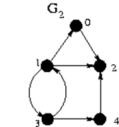
Graph Basics
In the next example we display a graph G₁ and a digraph G₂ both of order 5.
The size of the graph G₁ is 6 where
  E(G₁) = {(0, 1), (0, 2), (1, 2), (2, 3), (2, 4), (3, 4)}
  V(G1) = {0,1,2,3,4}
The size of the digraph G2 is 7 where
  E(G2)= {(0, 2), (1, 0), (1, 2), (1, 3), (3, 1), (3, 4), (4, 2)}
  V(G1) = {0,1,2,3,4}

Slide 26
Graph Basics
A walk in a graph (digraph) G is a sequence of vertices v₀ v₁…v_{n} such that, for all 0<=i<n, (v_{i}, v_{i+1}), is an edge (arc) in G
The length of the walk v₀v₁…v_{n} is the number n (i.e., number of edges/arcs)
A path is a walk in which no edge is repeated
A path of length k from a vertex u to a vertex u' in a graph G = (V, E) is a sequence v₀, v₁, v₂, . . . , v_{k} of vertices such that u = v₀, u' = v_{k}
A path is simple if all vertices in the path are distinct
A cycle is a walk (of length at least three for graphs) in which v₀ v₁…v_{n} and v₀ = v_{n} and no other vertex is repeated; sometimes, if it is understood, we omit v_{n} from the sequence

Slide 27

Graph Basics
For the graph G₁ of the following sequences of vertices are classified as being walks, paths, or cycles

Slide 28

Graph Basics
For the digraph G₂ of the following sequences of vertices are classified as being walks, paths, or cycles

Slide 29
Graph Basics
A graph G is connected if there is a path between all pairs of vertices u and v
The graph G₁ is connected as it is possible to find path between any two pair of vertices
The di-graph G₂ is not connected as there are some pairs of vertices that we couldn’t find path that link them (say from 0 to 1, from 0 to 4)

Slide 30
Graph Basics
A digraph G is strongly connected if there is a path from vertex u to vertex v for all pairs u and v in V(G)
The digraph G₂ is not strongly connected because there are no arcs leaving vertex 2
The underlying graph (by replacing each arc with an edge) of G₂ is connected, however.

Slide 31
Graph Basics
A connected graph has a path between every pair of vertices.
A disconnected graph is a graph which is not connected.
  Eg: The first graph below is a connected graph and the second one is disconnected.
In a disconnected graph, we can define the number of disconnected components which refers to the number of disjoint set
1
4
2
3

Slide 32
Graph Basics
A graph is said to be regular graph if all vertices have the same degree.
A regular graph with each vertex having degree r is called r-regular graph
If G is r-regular with m vertices it must have ½mr edges
A null graph is a graph with no edges.
The null graph with m vertices is denoted N_{m}. Nm is 0-regular.
A cycle graph consists of a single cycle of vertices and edges.

Slide 33
Graph Basics
Exercise
Prove that an r-regular graph G with m vertices must have ½mr edges (prove by contradiction)

Slide 34
Graph Basics
Two graphs G and H are isomorphic if H can be obtained by relabeling the vertices of G
i.e there is a one-to-one correspondence between the vertices of G and those of H such that the number of edges joining each pair of vertices in G is equal to the number of edges joining the corresponding pair of vertices in H (a v, b t, c s, d r, e u)
a
r
b
t
v
d
e
u
c
s

Slide 35
Graph Basics
A sub-graph of G is a graph all of whose vertices and edges are vertices and edges of G (i.e its vertex and edge sets are subset of those of G).
Spanning tree of a connected graph is a connected sub-graph in which its set of vertices and the vertices of the graph are the same and no cycle exists in the sub graph
A spanning tree with N vertices will have N-1 edges
Minimal spanning tree is a spanning formed from a weighted graph which has the smallest total cost (sum of weights of all the edges)

Slide 36
Graph Basics
Exercise
Prove that a spanning tree with N vertices will have N-1 edges

Slide 37
Graph Basics
Draw a link for the following graphs based on the graph information given below
V = {1,2,3,4} E1 = {(1,2), (1,3), (2,3), (1,4), (3,4), (4,4)}
1
4
2
3

Slide 38
Graph Representation
There are two standard ways to represent a graph G = (V, E):
  as a collection of Adjacency list
  As an adjacency matrix

Slide 39

Graph Representation (As an adjacency matrix)
For a graph G of order n, an adjacency matrix representation is a Boolean matrix (often encoded with 0's and 1's) of dimension n such that entry (i, j) is true if and only if edge/arc (i,j) is in E(G)
An adjacency matrices for the graph G₁ is given below

Slide 40

Graph Representation
An adjacency matrices for the graph G2 is given below
Notice that the 1's in the rows represent how many out-neighbours and the 1's in the columns represent how many in-neighbours a vertex has

Slide 41

Graph Representation (adjacency lists representation)
For a graph G of order n, an adjacency lists representation is n lists such that the i-th list contains a sequence (often sorted) of out-neighbours of vertex i of G
adjacency lists for the graph G₁

Slide 42

Graph Representation (adjacency lists representation)
adjacency lists for the graph G₂
Only the out-neighbours are listed in the adjacency lists representation

Slide 43
Graph Representation
For a graph/digraph with n vertices and m edges, the adjacency matrix representation requires O(n²) storage while the adjacency lists representation requires O(m + n) storage
To check whether edge/arc (i, j) is in the graph, the adjacency matrix representation has constant-time lookup (i.e. O(1)), while the adjacency lists representation may require O(n) time in the worst case

Slide 44
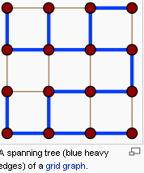
Spanning tree
Spanning tree T of a connected, undirected graph G is a tree composed of all the vertices and some (or perhaps all) of the edges of G.
Informally, a spanning tree of G is a selection of edges of G that form a tree spanning every vertex.
That is, every vertex lies in the tree, but no cycles (or loops) are formed.

Slide 45
Spanning tree
A single graph can have many different spanning trees.
We can also assign a weight to each edge, which is a number representing how unfavorable it is, and use this to assign a weight to a spanning tree by computing the sum of the weights of the edges in that spanning tree.
A minimum spanning tree or minimum weight spanning tree is then a spanning tree with weight less than or equal to the weight of every other spanning tree.
More generally, any undirected graph (not necessarily connected) has a minimum spanning forest, which is a union of minimum spanning trees for its connected components.

Slide 46
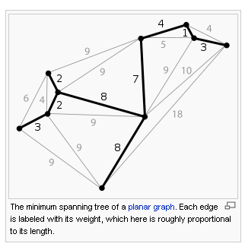
Spanning tree

Slide 47
Graph Traversals
Given a graph, one of the fundamental graph problems is to traverse every edge and vertex in a graph so as to:
  count the number of edges
  identify connected components of a graph
Goal: visit all (or some) vertices and edges of the graph using some strategy (the order of visit is systematic)

Slide 48
Graph Traversals
Two Most Common Approaches
  Depth First Traversal (DFT) and
  Breadth First Traversal(BFS)
The order of exploring the vertices depends upon the data structure used

Slide 49
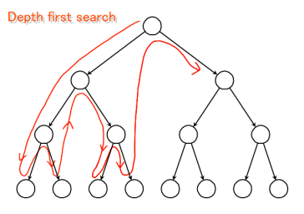
Graph Traversals
Depth First Traversal
In DFT, as each vertex v is visited, all of it’s children are added to front for immediate processing

Slide 50
Graph Traversals
Depth First Traversal
Use of a stack leads to a depth-first visit order.
Stack is used to keep track of: nodes to be visited next, or nodes that we have already visited.
  Stack: by storing the vertices in a stack, DFT explores vertices following LIFO order. Thus, it constantly visit a new neighbor depth-wise.

Slide 51
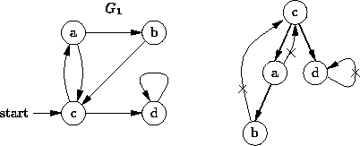
Depth-First Traversal
Strategy: Go as far as you can (if there is unvisited node depth-wise); otherwise, go back and try another way
The depth-first traversal visits the nodes in the order - c, a, b, d
Remark:
A depth-first traversal only follows edges that lead to unvisited vertices.
if we omit the edges that are not followed, the remaining edges form a tree.

Slide 52
DFT: Algorithm
procedure DFT( v )
  visited (v) = 1; //Mark v as visited
  For each vertex u adjacent to v do
    If (visited (u) = 0) then //if vertex u is unvisited
      DFT(u)
end
procedure GraphTraversal()
  for i = 1 to n // n is the number of vertices v
    visited(v_{i}) = 0; //Mark v as unvisited
  for i = 1 to n
  if (visited(v_{i}) = 0)
    DFT(v_{i})
end

Slide 53
Depth-First Traversal
Result of DFS:
  Every edge of G is labeled as either a ‘tree’ edge or a ‘back’ edge.
  If G is connected, the tree edges form a spanning tree – called a depth-first spanning tree. (Otherwise they form a spanning forest).

Slide 54
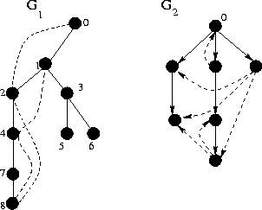
Depth-First Traversal
Example
  Depth-first search trees (originating from vertex 0) of the graph G1 and digraph G2 show earlier are displayed below.
  The dashed edges/arcs indicate the original edges/arcs that are not part of the DFS trees

Slide 55
Properties of Depth-First Search
If implemented with adjacency matrix, runs in time O(n²)
If implemented with adjacency list, runs in time O(n + e)
  In general, runs in time proportional to size of data structure used to represent graph
Can be used for: Finding spanning forest; cycle detection; finding path between vertices u and v; testing for connectedness; testing bipartiteness; bridge detection; cut point detection

Slide 56
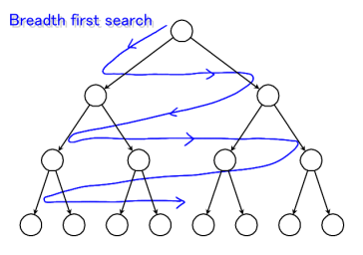
Graph Traversals
Breadth First Traversal
In BFT, as each vertex v is visited all of it’s unvisited children are kept in a waiting list

Slide 57
Graph Traversals
Breadth First Traversal
Use of a queue leads to a breadth-first visit order.
Queue is used to keep track of: nodes to be visited next, or nodes that we have already visited.
  By storing the vertices in a queue, BFS explores vertices following FIFO order. Thus, it explores starting the initial vertex level by level.

Slide 58
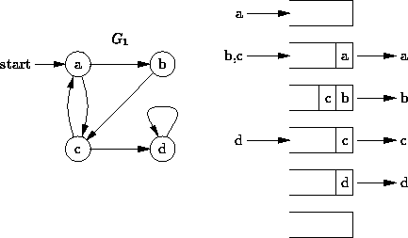
Breadth-First Traversal (BFT)
In DFT, we choose the most recently visited vertex to expand. Where as, BFS explores the vertices in the order of their distance from the start vertex level-wise.
BFT examines every path of length i before going on to paths of length i+1.
BFT visits the nodes in the order: a, b, c, d

Slide 59
BFT: Algorithm
procedure BFT( v )
  visited (v) = 1; //Mark v as visited
  enqueue(v)
  do{
    for all vertices u adjacent to v do
      If visited(u) = 0
        visited(u) =1 enqueue(u)
    v = dequeue()
  }while queue is not empty
end
procedure GraphTraversal()
  initialize visited(v) = 0; //Mark v as unvisited
  for i = 1 to n // n is the number of vertices v
  if (visited(v_{i}) = 0)
    BFT(v_{i})
end

Slide 60
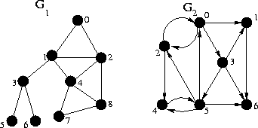

Breadth-First Traversal (BFT)
Example
  Consider a graph G1 with its adjacency list representation

Slide 61
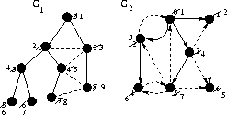
Breadth-First Traversal (BFT)
The dashed edges/arcs in the next diagram indicate the original edges/arcs that are not part of the BFS trees
A graph may have more than one possible BFT tree depending on the way the tree is grown at each level
For a given tree generated by BFT, we can uniquely label the vertices of a graph based on the level-order traversal

Slide 62

Breadth-First Traversal (BFT)
Example
  Consider a digraph G2 with its adjacency list representation

Slide 63
Breadth-First Traversal (BFT)
Result of BFS:
  If G is connected, the tree edges form a spanning tree – called a breadth-first spanning tree. (Otherwise they form a spanning forest).
  If v is the root of a BFS spanning tree T, then the path from v to w in T is a shortest path from v to w in G.

Slide 64
Graph Searching
The traversal algorithms breadth-first traversal (BFS) and depth-first traversal (DFT) can be modified into graph searching.
Breadth-First Search (BFS)
  While performing BFT, stop when ever the current vertex full fill the requirement
Depth-First Search (BFS)
  While performing DFT, stop when ever the current vertex full fill the requirement

Slide 65
Graph Traversals
Some shortest path algorithms and spanning tree algorithms have specific visit order

Slide 66
Time complexity
Proof: Depending on the graph representation, time complexity for DFS and BFS is the same:
  If Adjacency matrix : O(V²)
  If Adjacency list : O(V + E)

Slide 67
Exercise
Show the order of traversing the following graphs using DFS and BFS starting from node 1
1
2
4
  DFS: 1→2→5→6→3→7→4
  BFS: 1→2→3→4→5→6→7
3
5
6
7
1
2
3
  DFS: 1→2→4→8→5→6→3→7
  BFS: 1→2→3→4→5→6→7→8
4
5
6
7
8

Slide 68
Exercise
Show the order of traversing the following graphs using DFS and BFS starting from node 1
1
2
3
  DFS: 1→2→4→8→5→6→3→7
  BFS: 1→2→3→4→5→6→7→8
4
5
6
7
Fig 1
8
1
2
4
  DFS: 1→2→5→6→3→7→4
  BFS: 1→2→3→4→5→6→7
3
Fig 2
5
6
7

Slide 69
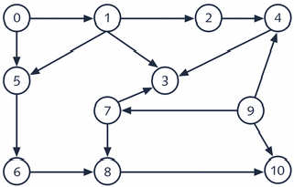
Exercise
Find the order of traversing the following graphs using DFS and BFS
Start at node 0
D
G
Start at node A
B
J
H
E
K
C
I
A
F
L

Slide 70
THE END

Slide 71
Disjoint sets: the problem
Many times the efficiency of an algorithm depends on the data structures used in the algorithm.
Choosing suitable data structure in solving a problem can reduce the time of execution, the time to implement the algorithm and the amount of memory used.

Slide 72
Disjoint sets: the problem
The problem
Let’s consider the following problem: In a room are N persons. Thus, two persons are friends if they are directly or indirectly friends.
  If A is a friend with B, and B is a friend with C, then A is a friend of C too.
  A group of friends is a group of persons where any two persons in the group are friends.
  Given the list of persons that are directly friends, find the number of groups of friends and the number of persons in each group.
  For example, N = 9 & the list of friends is: 1-2, 3-4, 5-1, 6-4, 7-9 and 8-2.

Slide 73
Disjoint sets
Some applications involve grouping n distinct elements into a collection of disjoint sets.
  Two sets are disjoint if their intersection is NULL: S₁ Λ S₂ = Ø
In disjoint set data structure:
  Each set is represented by a tree, so that each element points to a parent in the tree.
  Every set contains a representative (root), which is also one of the member of the set

Slide 74
Disjoint sets
Applications
  Maintain the connected components of a graph as new vertices and edges are added.
  To solve the problem of spanning tree (Kruskal algorithm).
  In both applications, we can use a disjoint-set data structure, where we keep a set for each connected component, containing that component's vertices.

Slide 75
Disjoint sets
Three operations
CREATE (x):
  Creates a new set {x} containing the single element x.
  The element x must not appear in any other set in our collection.
  The root/leader of the new set is obviously x.
UNION(x,y):
  combines/merges two disjoint sets containing root x and root y into one set.
  replaces two sets, A and B with their union A U B.
FIND(x):
  finds in which set a given node x belongs to and returns the root node of the set containing the element x.

Slide 76
Algorithm for Disjoint set
algorithm DisjointSet(x, n)
//input x[1,2, …,n]
FOR i = 1 to n DO
CREATE(x_{i})
end for
FOR (each pair of friends (x_{i}, x_{j}) ) DO
IF (FIND(x_{i}) != FIND(x_{j})) THEN
UNION(x_{i}, x_{j})
end if
end for
end algorithm
FIND() operation check if the two pairs, x_{i} & x_{j} are in the same group or not, before merging them using UNION() operation

Slide 77
Algorithms: Create, Union & Find operations
procedure CREATE(x)
parent(x) = -1 //some negative number
end
procedure UNION(x,y)
parent(x) = y
end
procedure FIND(x)
y = x
while parent(y) > 0 do
y = parent(y)
end while
return y
end
Determine time complexity of the above algorithms?

Slide 78
Improving UNION and FIND operations
Analyze the total time required for performing the following operations:
UNION(1,2), UNION(2,3), …, UNION(n-1,n), and
FIND(1), FIND(2), …, FIND(n)
There is a need to enhance the efficiency of UNION and FIND operations.
  Notice that the time to do a FIND operation on an element corresponds to its depth in the tree.
Can we improve the performance of UNION and FIND?
  Improve means decrease the height of the trees
  Hence our goal is to keep the trees as short as possible.

Slide 79
Two heuristics
Two heuristics for keeping the height of the disjoint trees short are UNION by rank and Path Compression
UNION by rank: ensures that when we combine two trees, we try to keep the overall depth of the resulting tree small.
  If x and y are roots of two distinct trees, this technique makes the root of the smaller tree a child of the root of the larger tree.
  Union by rank avoids creation of degenerate trees
Path compression: collapses all nodes to point to root node.
  Is used during FIND operation so as to make each node on the find path point directly to the root

Slide 80
UNION by rank
UNION by rank: balances the height of a tree.
  The idea is that the rank of the root is associated with the depth of the tree so as to keep the depth small.
Weighting rule for UNION(x,y): If the number of nodes in tree with root x is less than the number in tree with root y, then make y the parent of x; otherwise, make x the parent of y.
procedure UNION(x,y)
z = parent(x) + parent(y)
if parent(x) > parent(y) then
parent(x) = y
parent(y) = z
else
parent(y) = x
parent(x) = z
end if
end UNION
To implement weighting rule there is a need to keep the number of nodes in every tree in the parent field of the root as –ve numbers.

Slide 81
Path Compression
Path compression reduces the complexity of FIND algorithm.
  This is done by collapsing nodes in a tree
Collapsing rule: If x is a node on the path from y to its root and parent[y] ≠ root[y], then set parent[x] to root[y]
  The idea is that, once we perform a FIND on some element, we should adjust its parent pointer so that it points directly to the root; that way, if we ever do another FIND on it, we start out much closer to the root.
function FIND(x)
y = x
while parent(y) > 0 do
y = parent(y) //Find root
z = x
while z ≠ y do //collapse nodes from z to root y
t = parent(z)
parent(z) = y
z = t
return y
end FIND

Slide 82
Exercise
E.g.: given S₁= {3,4,6},S₂ ={1,7,8,9} & S₃ = {2,5,10}, represent them using disjoint set tree?

Slide 83

Social Networks
A social network is a graph where the objects are people,
and the links show a social relationship.
"FOAF (an acronym of Friend of a Friend) is a machine-readable ontology describing
persons, their activities and their relations to other people and objects.
FOAF allows groups of people to describe social networks ...
FOAF is an extension to RDF Resource Description Framework and is
defined using OWL Web Ontology Language. "
(From wikipedia)
How far apart can two people be? How
many links do I need to follow to get from
one website to another? Which websites (or
people) are the most connected?

Slide 84
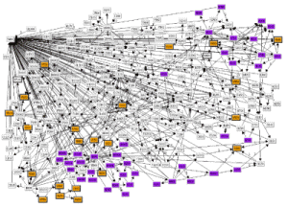
Call graphs
Each link represents a call between
two telephone numbers
Note: multiple links between nodes
Each link represents a
function call between
two different modules in
a large software system
Recursive functions will require
an edge from a node to itself
Image taken from "Release: Reconstruction of Legacy Systems for Evolutionary Change", by Munro
Burd and Young, The Centre for Software Maintenance, University of Durham

Slide 85
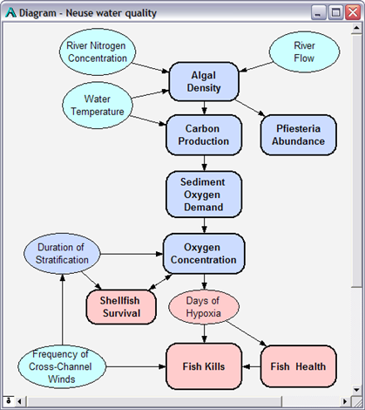
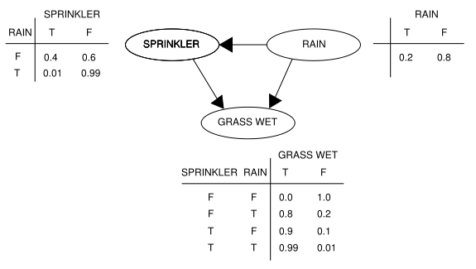
Bayesian Networks and Influence Diagrams
representing the
presence of an
influence between
two parameters
Note: links now have a direction

Slide 86
Project Planning
A set of tasks to complete. Graph shows precedence order.
3
5
T1
T2
Numbers show time
to complete the task
5
2
T3
T9
0
T6
T4
2
3
2
T5
Note: nodes now have a label
T7
T8
4
4
How quickly can I finish all my tasks?
How many resources would I need?
If I have 2 resources, how quickly can I finish?

